Slide 1
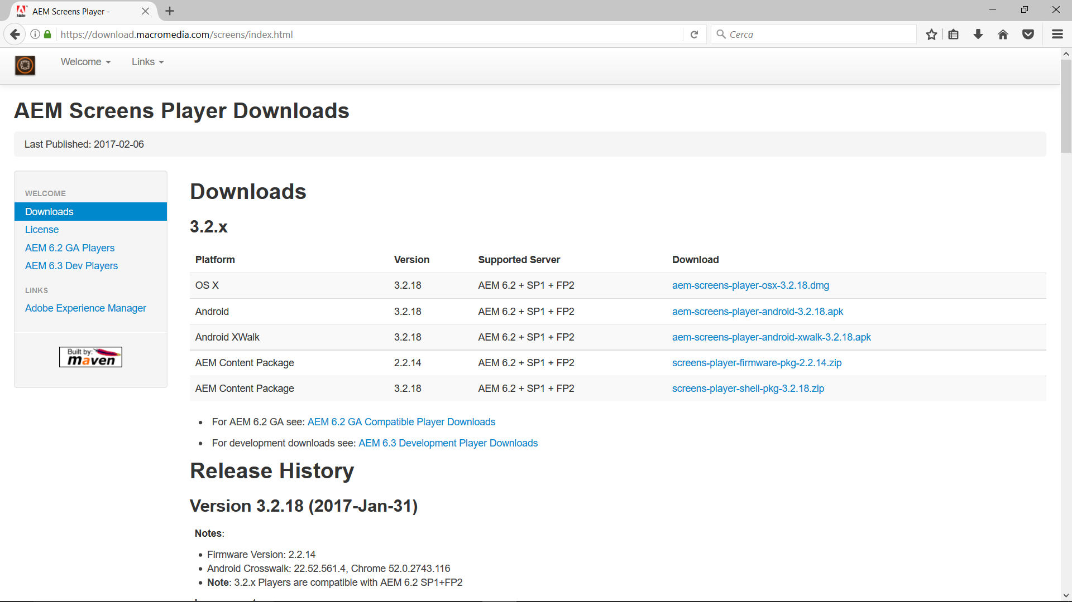

Slide 2
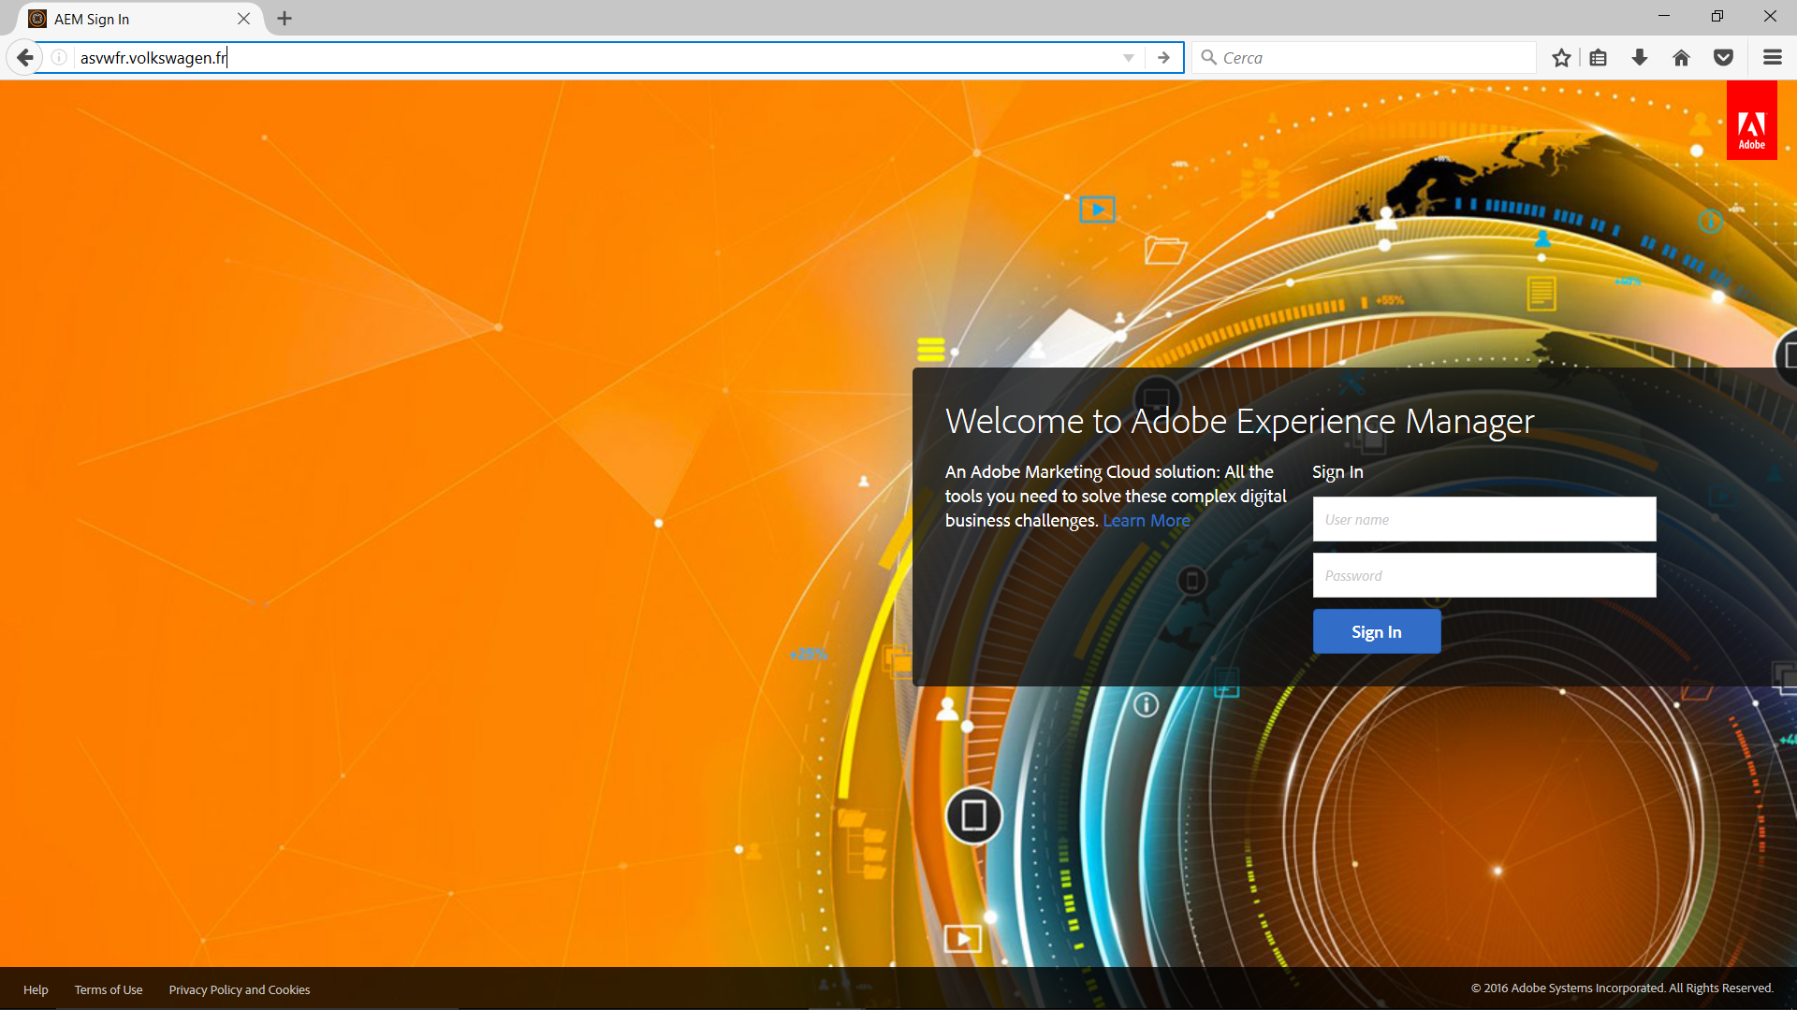
Login

Slide 3
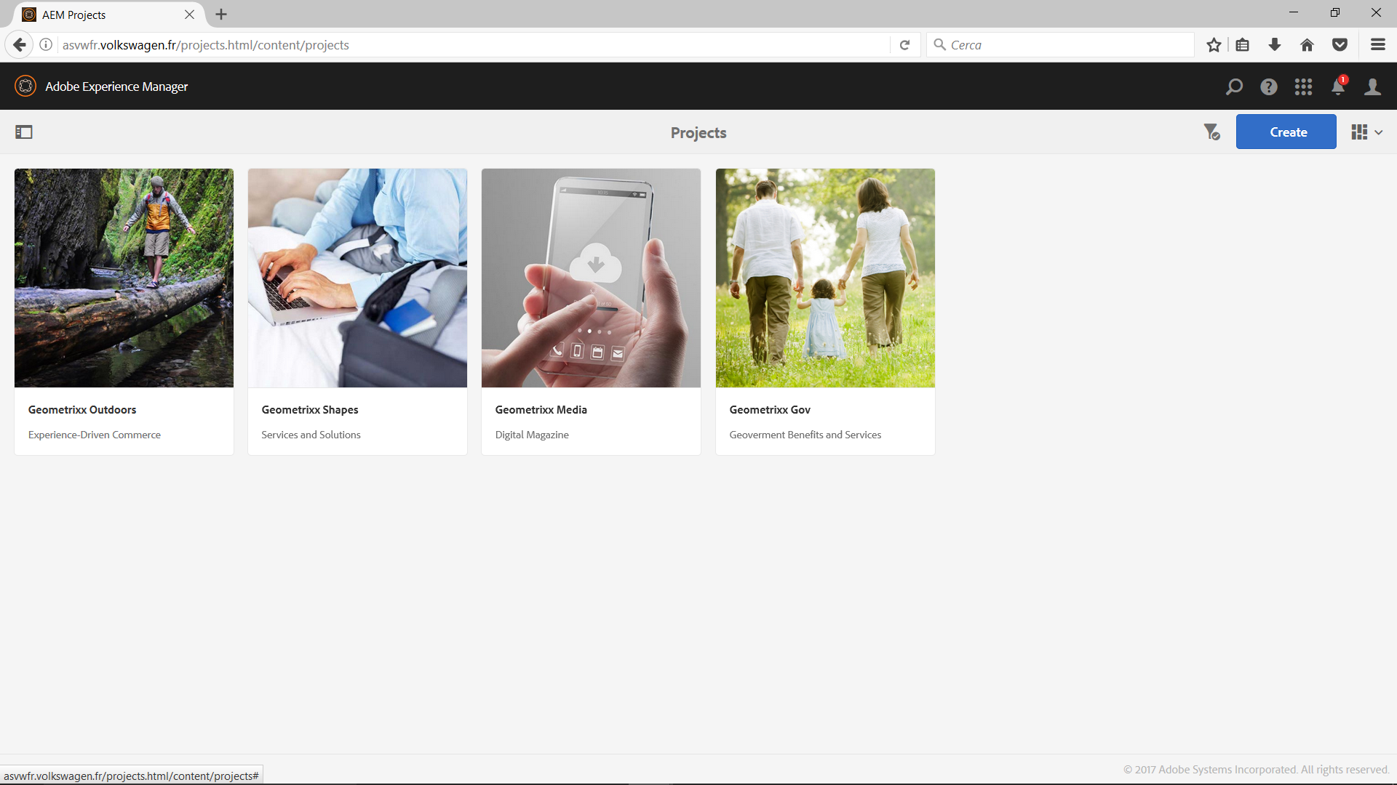
Click
Login

Slide 4
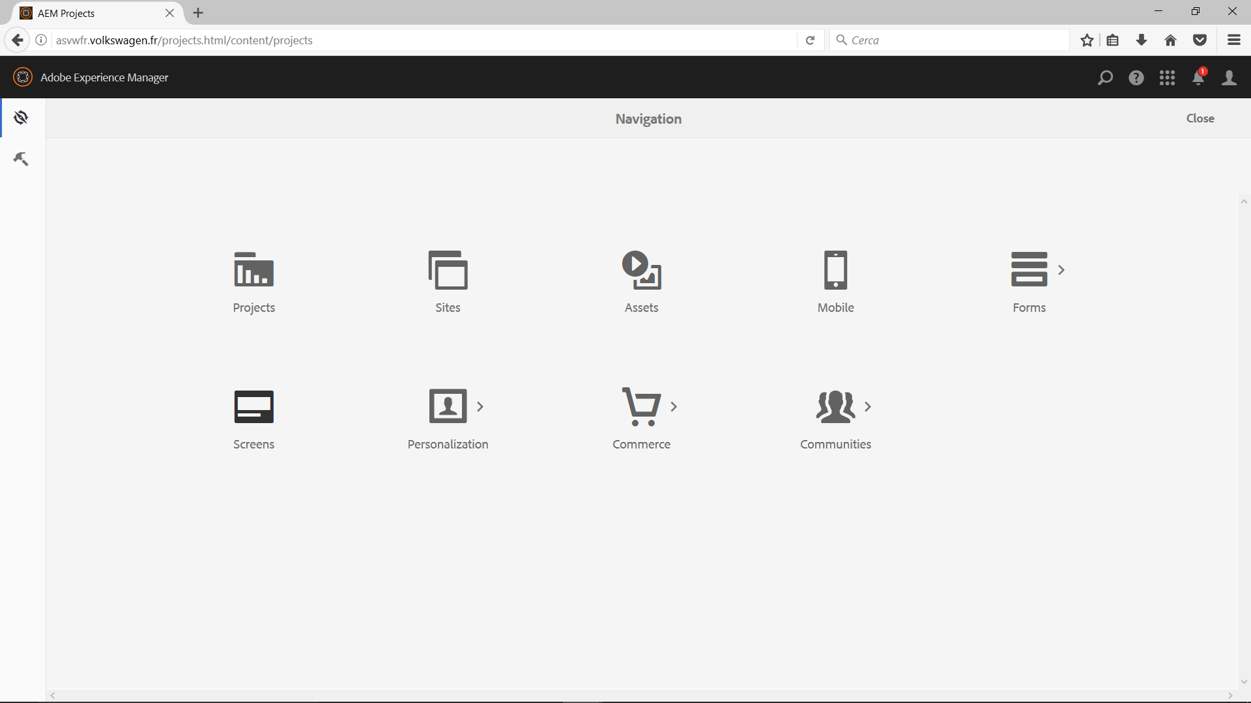
Click

Slide 5
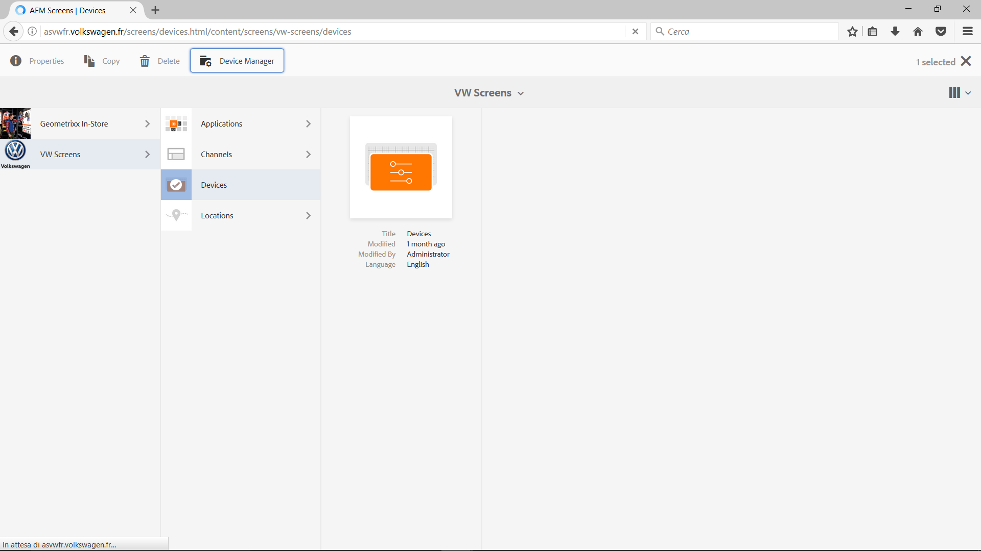
Click
Click
Click

Slide 6
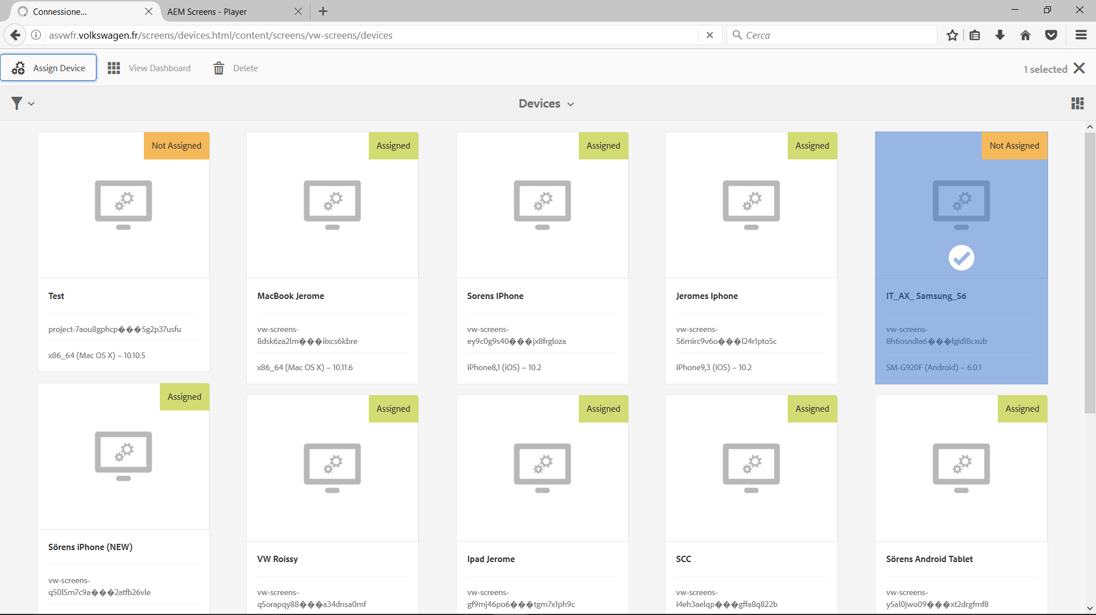
Click
Select

Slide 7
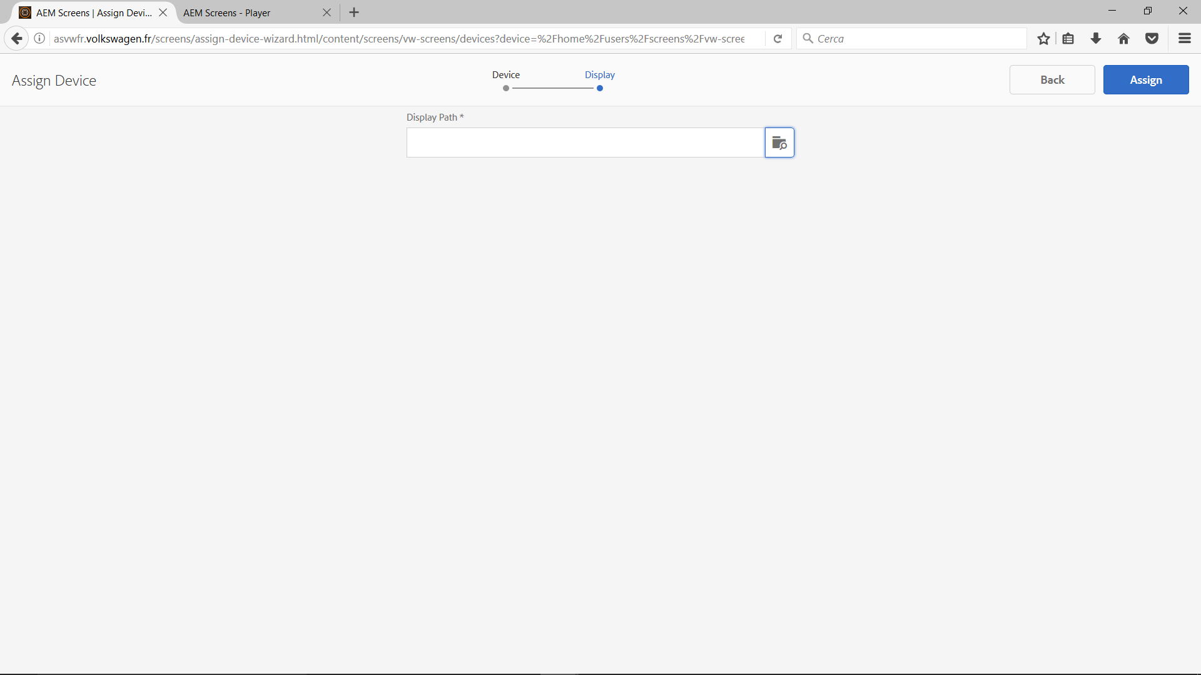
Click

Slide 8
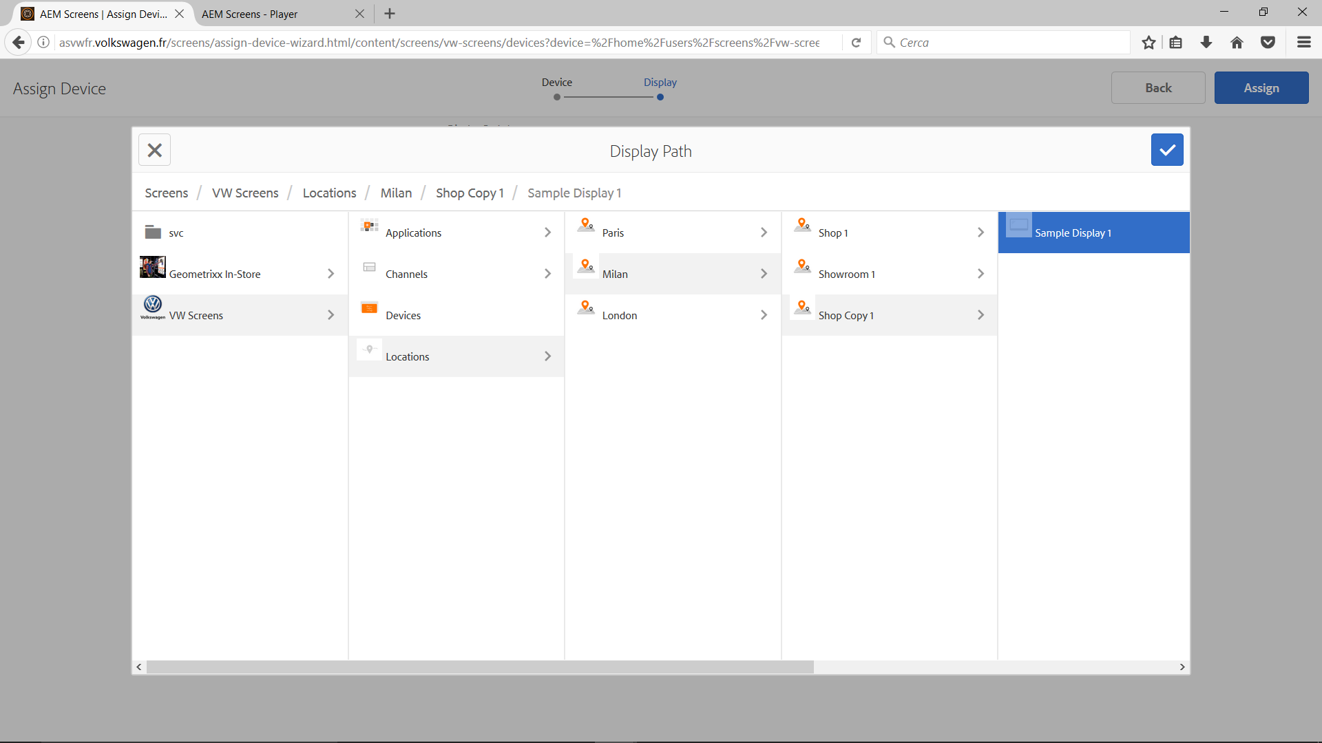
Click
Select
Click
Click
Click
Click

Slide 9
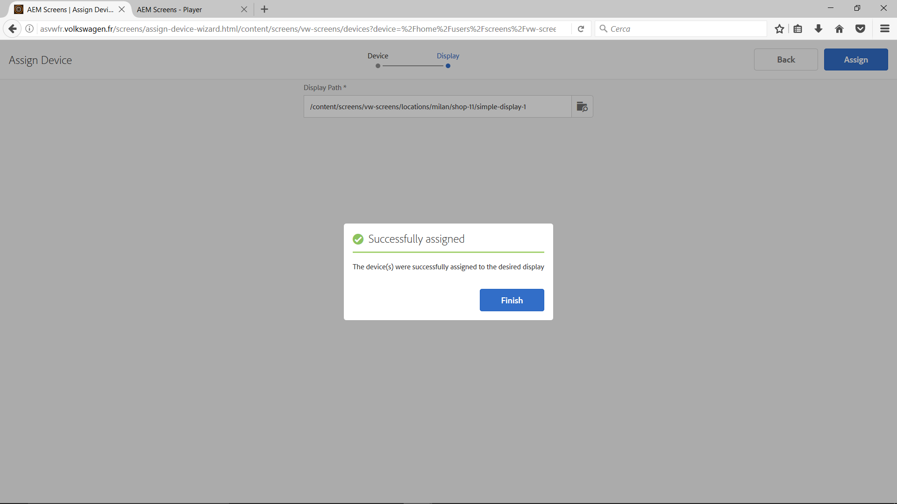
Click
Click

Slide 10
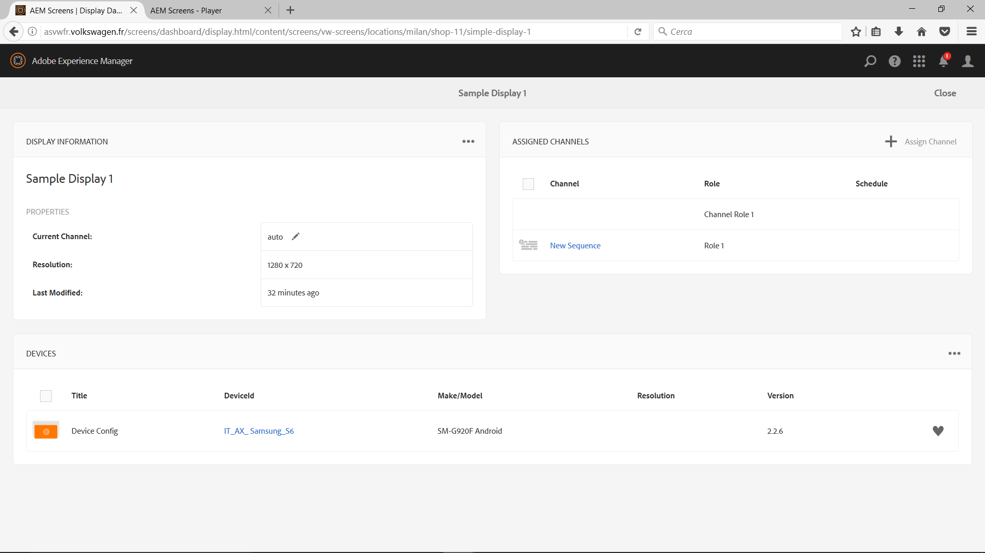
Click

Slide 11
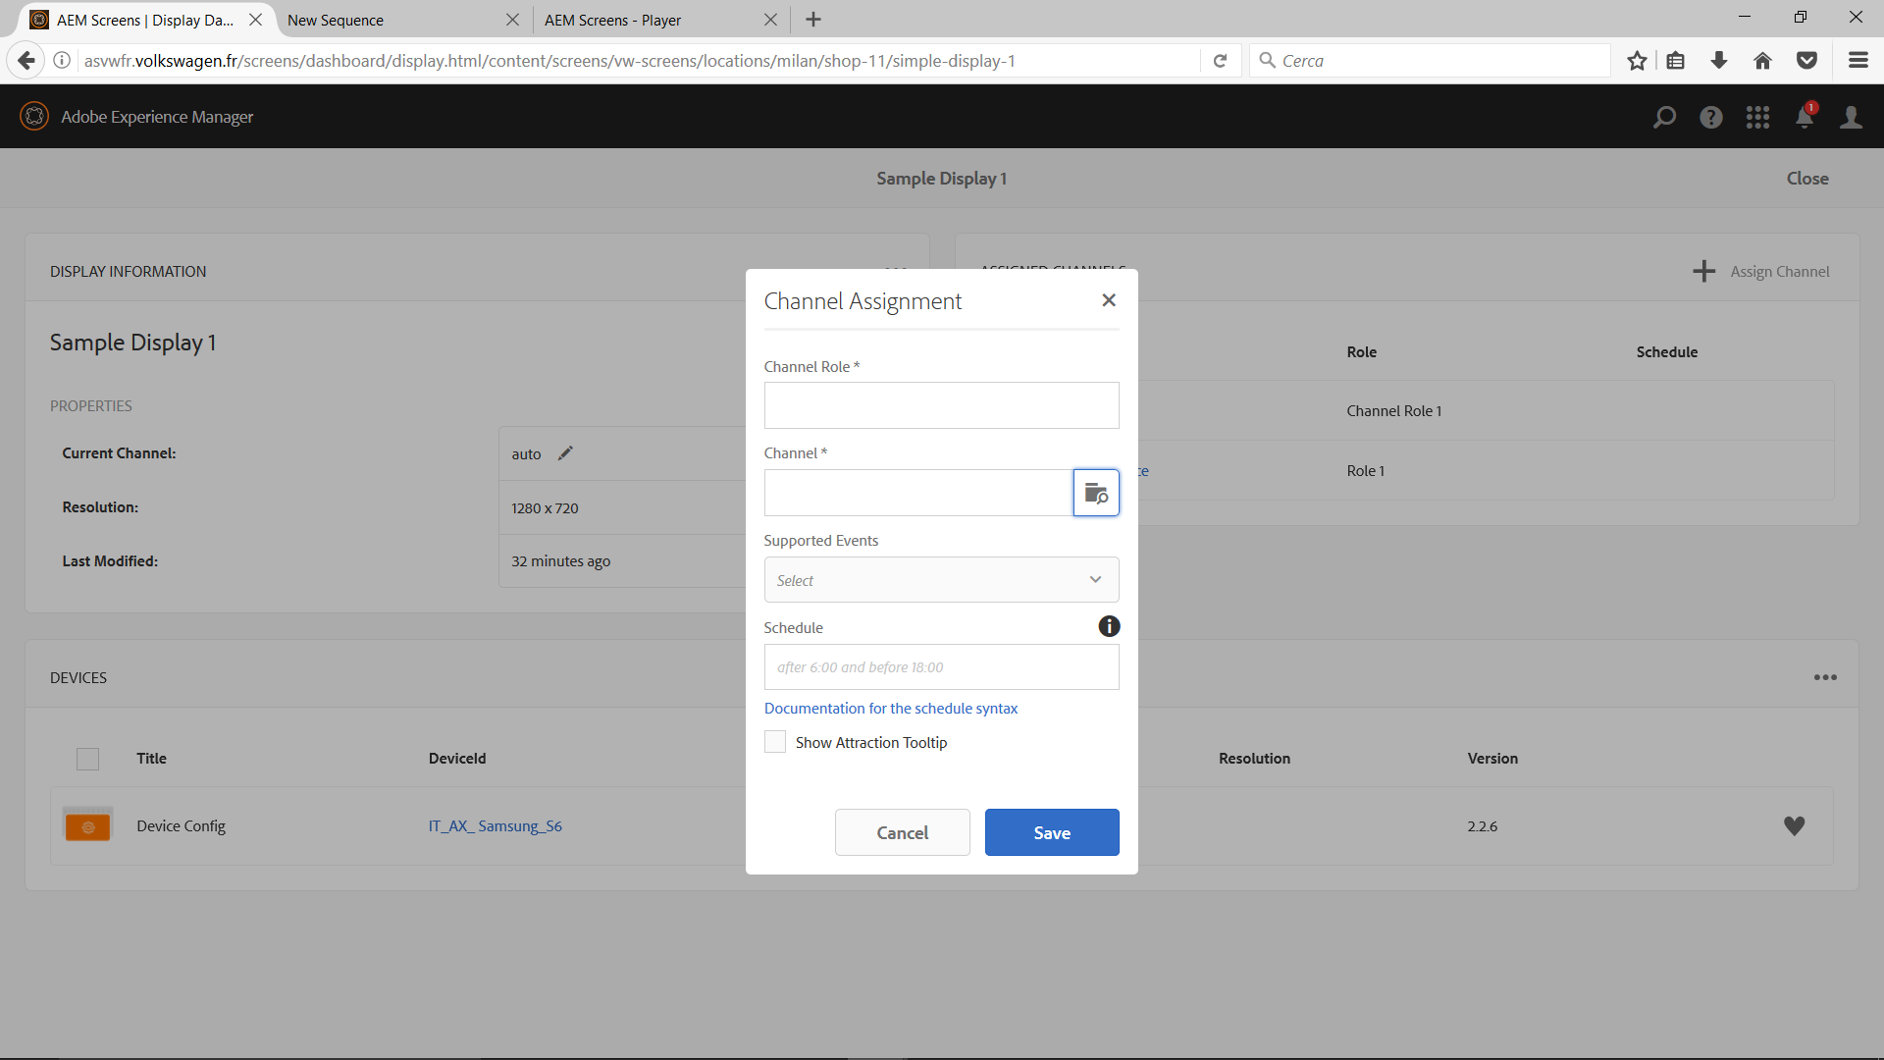
Input
Click
Click

Slide 12
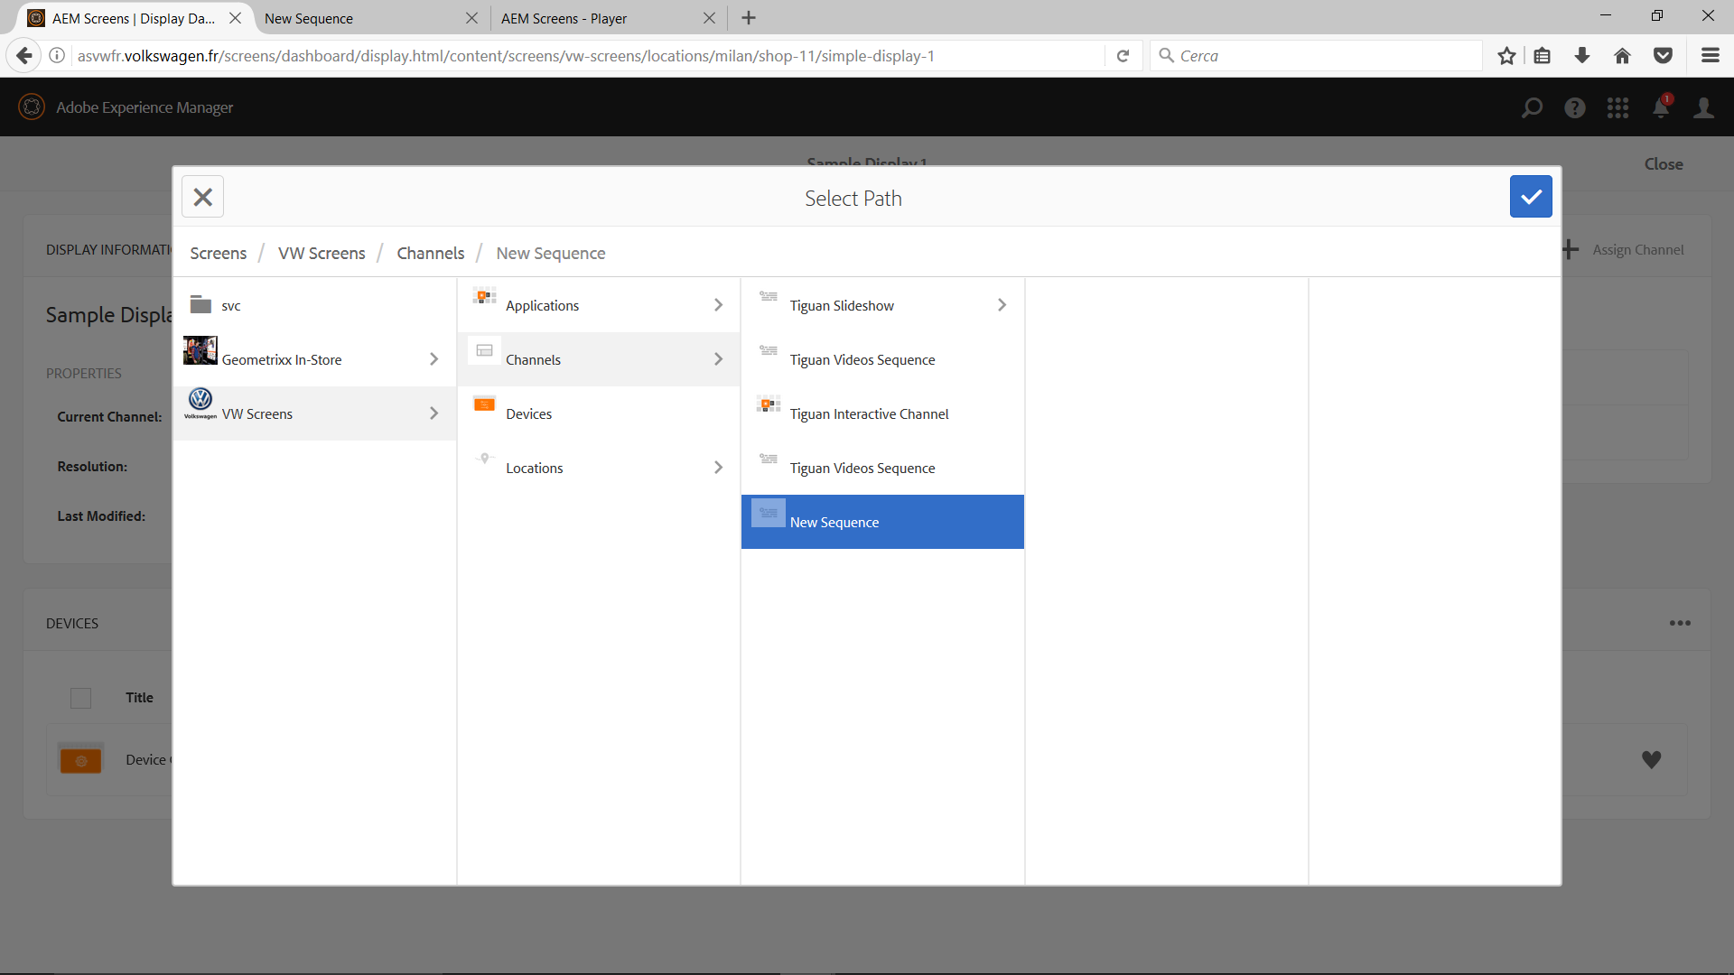
Click
Click
Click
Select

Slide 13
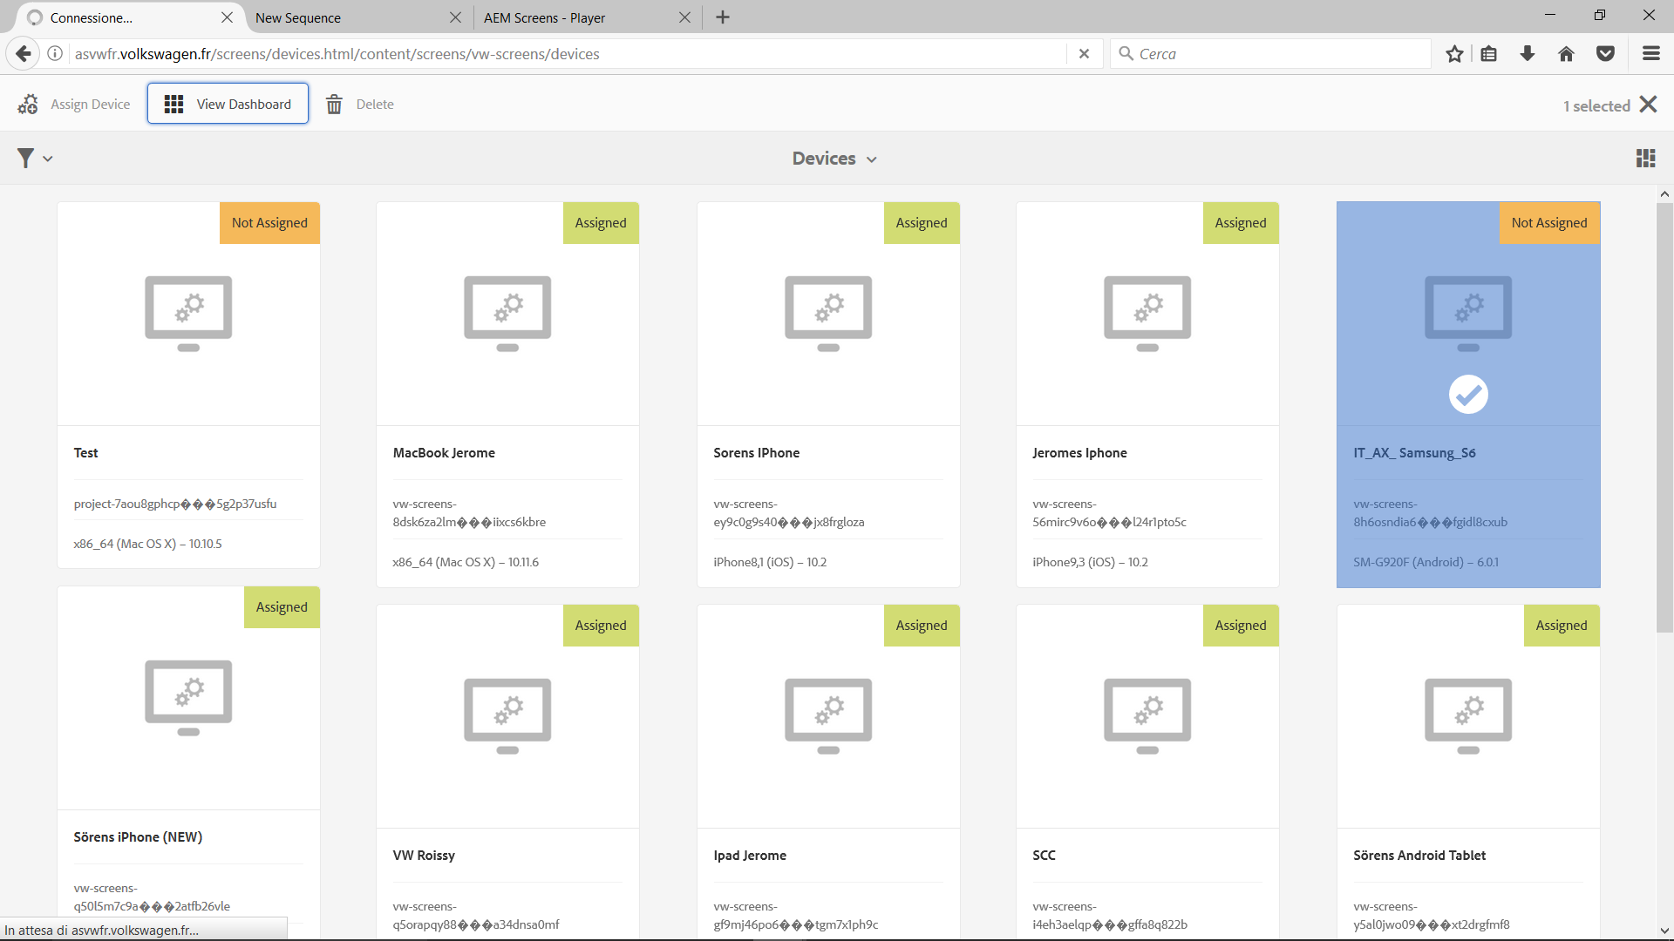
Click
Select

Slide 14
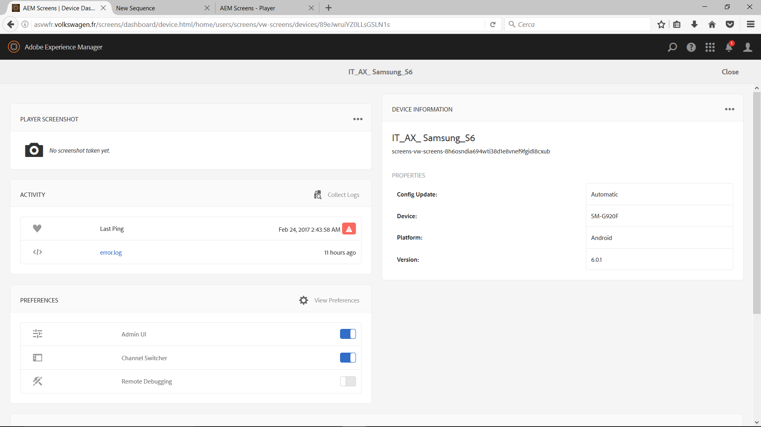
Click

Slide 15
Adobe Experience Manager 6.2 Device Control Center
https://docs.adobe.com/docs/en/aem/6-2/administer/screens/dcc.html

Slide 16
Adobe Experience Manager 6.2 Adobe Player
https://docs.adobe.com/docs/en/aem/6-2/deploy/screens.html

